Slide 1

Chapter 9
Solids and Fluids

Slide 2
States of Matter
Solid
Liquid
Gas
Plasma

Slide 3
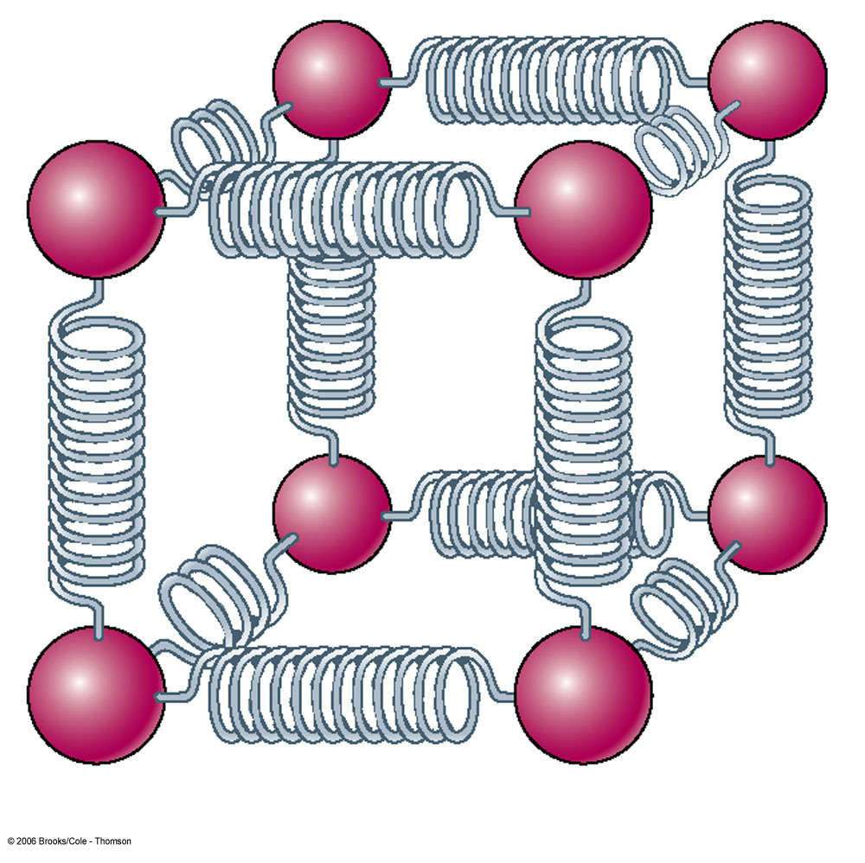
Solids
Has definite volume
Has definite shape
Molecules are held in specific locations
  by electrical forces
vibrate about equilibrium positions
Can be modeled as springs connecting molecules

Slide 4
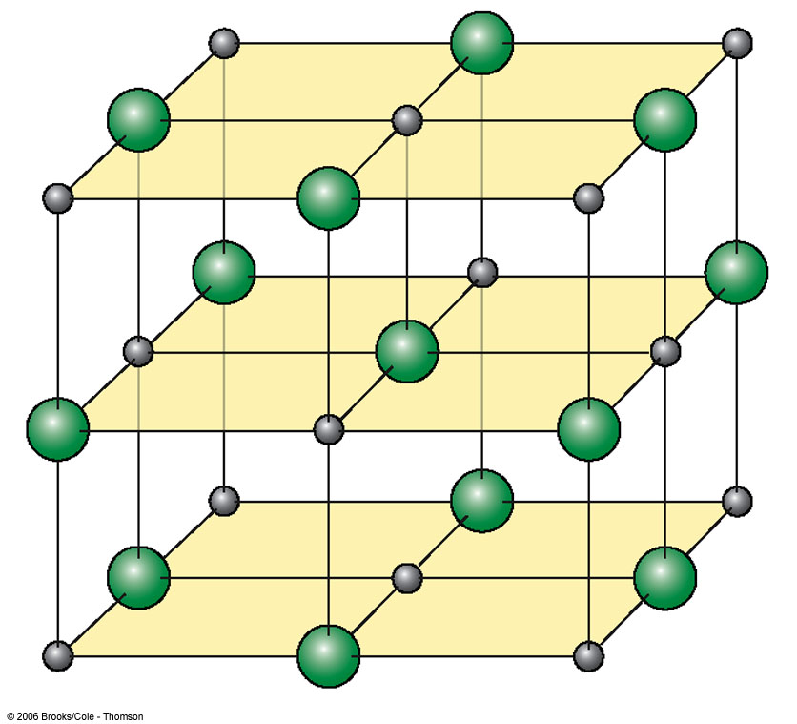
Crystalline Solid
Atoms have an ordered structure
This example is salt
  Gray spheres represent Na⁺ ions
  Green spheres represent Cl⁻ ions

Slide 5
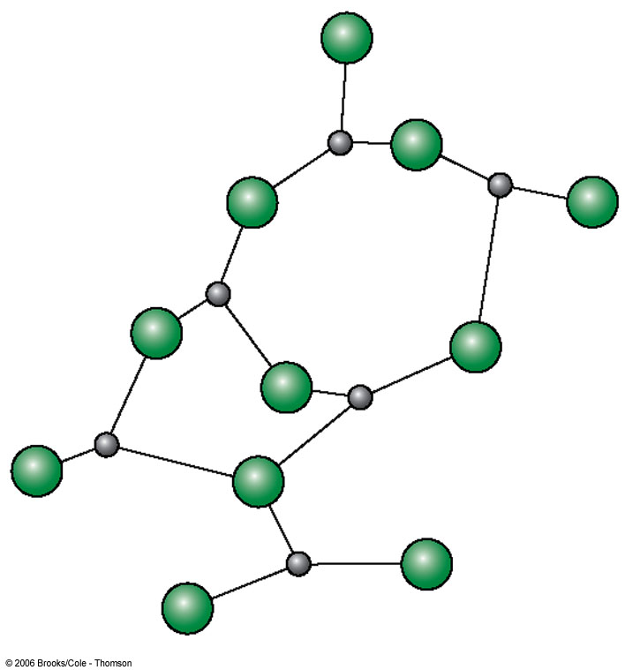
Amorphous Solid
Atoms are arranged almost randomly
Examples include glass

Slide 6
The fundamental difference between crystals and amorphous solids
Crystalline materials have a long-range ordered lattice structure, with their constituent atoms or units arranged in a fixed spatial pattern.
Amorphous materials, like liquids, have atomic order only over a short range, on the order of a few atomic distances. (Short-range order)

Slide 7
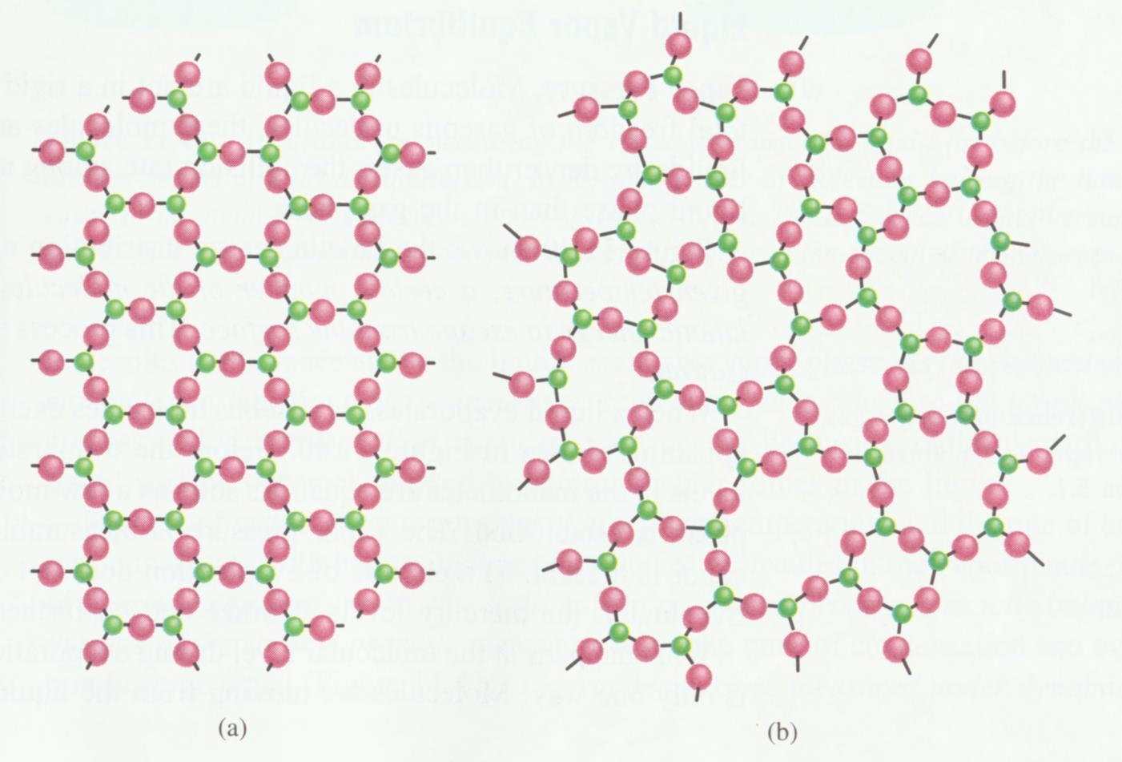
The fundamental difference between crystals and amorphous solids

Slide 8
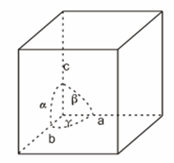
Unit cell theory
In 1784, French scientist René Just Haüy proposed the famous unit cell theory:
every crystal has a smallest unit cell with a specific shape;
large crystals are formed by stacking numerous unit cells together.
This was the first hypothesis in crystallography that crystals, from their appearance to their essence, were understood.

Slide 9
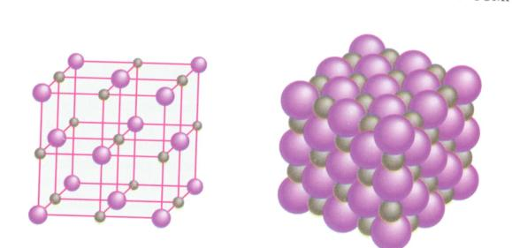
Unit cell
The basic unit that characterizes a crystal structure is called a unit cell (including the form and size of the lattice and the particles located at the lattice nodes). For example, the unit cell below is a NaCl unit cell, containing 4 Na and 4 Cl atoms.

Slide 10
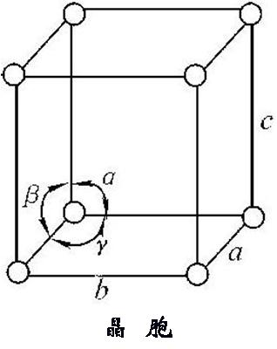
Unit cell parameters
The unit cell is the smallest basic unit of the crystal lattice. A unit cell is a parallelepiped. Within a crystal, the type, number, position, and orientation of the structural units on parallel faces are identical. However, the three sides of a unit cell are not necessarily equal in length or perpendicular to each other. The shape and size of a unit cell are expressed using unit cell parameters: the lengths a, b, and c of the three sides and the angles between them. Unit cells are stacked seamlessly in three-dimensional space to form a crystal.

Slide 11
According to the edge length of the unit cell and the angle between the crystal faces, crystals are divided into seven types, usually called the seven crystal systems：
立方（cubic）、
四方（tetragonal）、
正交（orthorhombic）、
三方（trigonal）、
六方（hexagonal）、
单斜（monoclinic） 、
三斜（triclinic）。

Slide 12
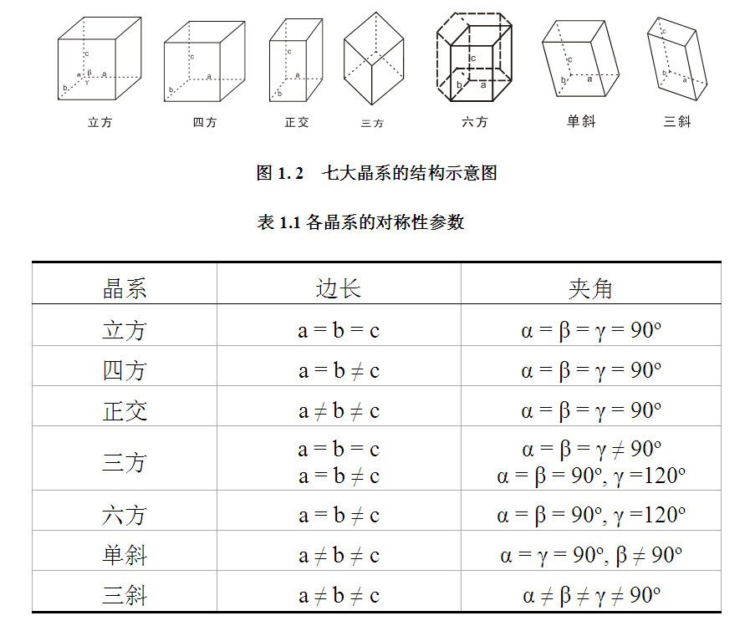
立方（cubic）、
四方（tetragonal）、
正交（orthorhombic）、
三方（trigonal）、
六方（hexagonal）、
单斜（monoclinic） 、
三斜（triclinic）。

Slide 13
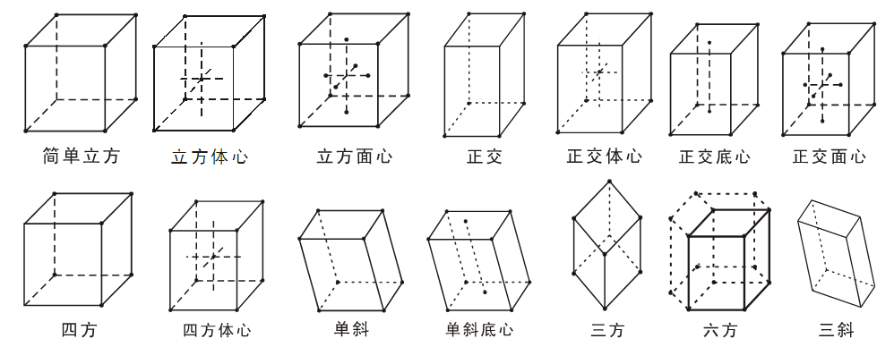
Seven crystal systems, fourteen crystal lattices

Slide 14
X ray
X-rays are electromagnetic waves with a wavelength of 0.01 to 100 Å.
γ射线
紫外线
红外线
无线电波
X射线
可见光
微波
１nm
１μm
１mm
１cm
１km
１Å
１m
１０^{－１５}
１０^{－１０}
１０^{－５}
１０^{０}
１０^{５}
波长（ｍ）

Slide 15
Generation of X-ray
＋
热电子
-
金属靶
高压电源
X射线管
X射线
When thermal electrons accelerated by high voltage bombard a metal target in a vacuum, X-rays are produced.

Slide 16
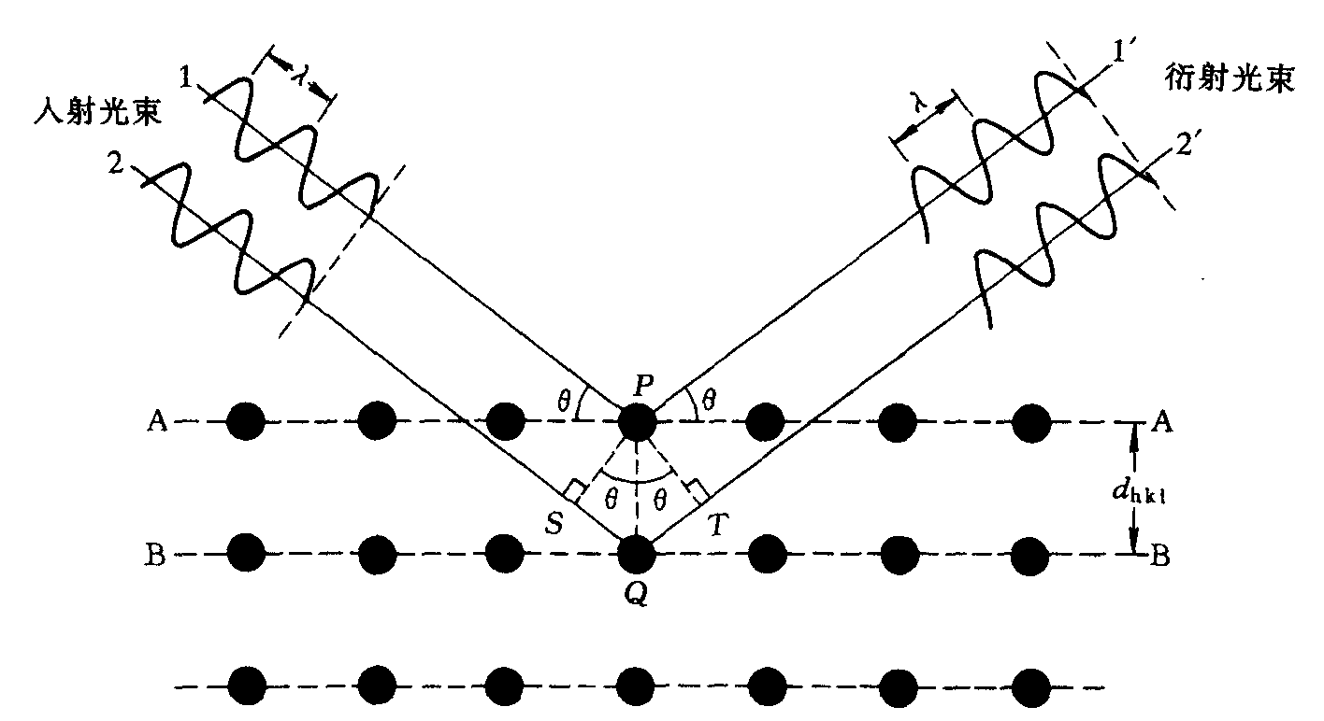

Slide 17
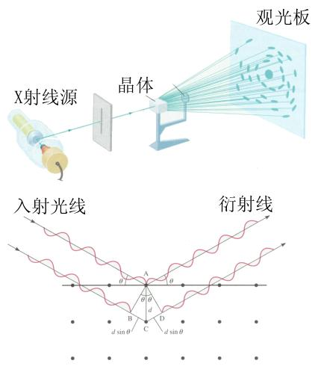
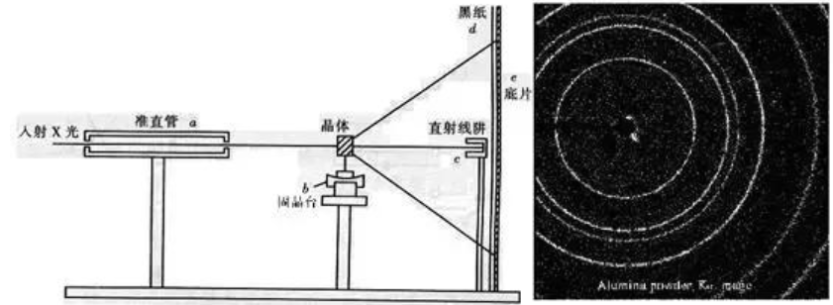

Slide 18
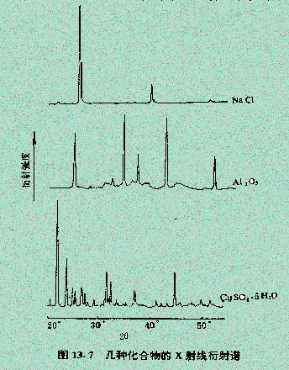
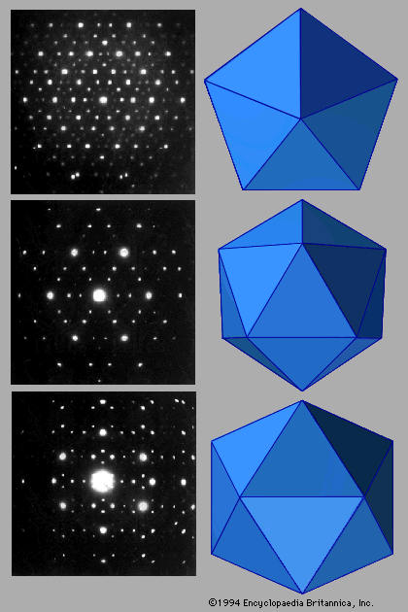
X-ray diffraction spectrum
X-ray diffraction spots

Slide 19
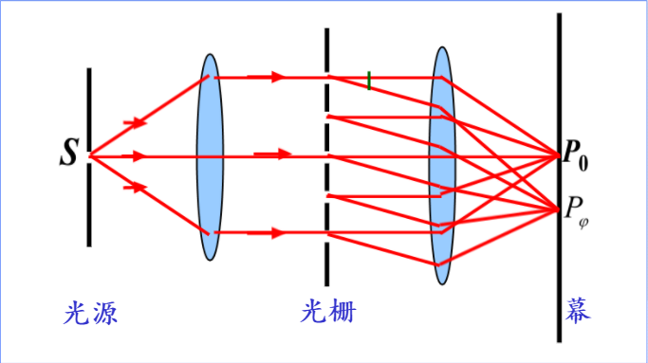
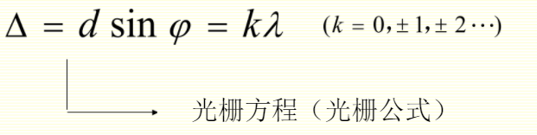

Slide 20

Grating constant measurement experiment
Grating constant measurement experiment

Slide 21
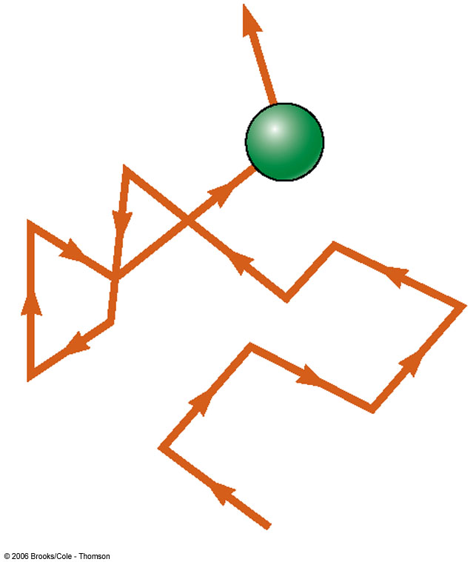
Liquid
Has a definite volume
But no definite shape
Exists at a higher temperature than solids
The molecules “wander” through the liquid in a random fashion
  The intermolecular forces are not strong enough to keep the molecules in a fixed position

Slide 22
Gas
Has no definite volume
And has no definite shape
Molecules are in constant random motion
The molecules exert only weak forces on each other
Average distance between molecules is large compared to the size of the molecules

Slide 23
Plasma
Matter heated to a very high temperature
Many of the electrons are freed from the nucleus (ionization)
Result is a collection of free, electrically charged ions
Plasmas exist inside stars and in space

Slide 24


Slide 25
Deformation of Solids
All objects are deformable
It is possible to change the shape or size (or both) of an object through the application of external forces
When the forces are removed, the object tends to its original shape
  This is a deformation that exhibits elastic behavior

Slide 26
Elastic Properties
Stress is the force per unit area causing the deformation (Stress = Force/Area)
Strain is a measure of the amount of deformation (Strain = Change/Original)
The elastic modulus is the constant of proportionality (or connection) between stress and strain
  For sufficiently small stresses, the stress is directly proportional to the strain
  The constant of proportionality depends on the material being deformed and the nature of the deformation

Slide 27
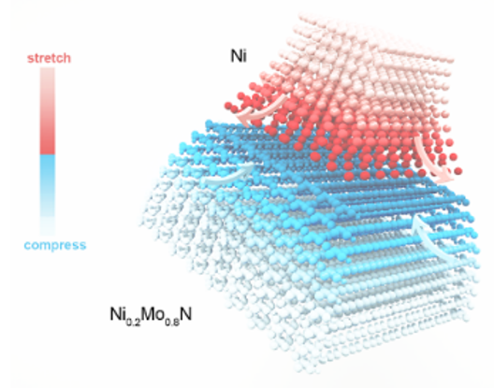



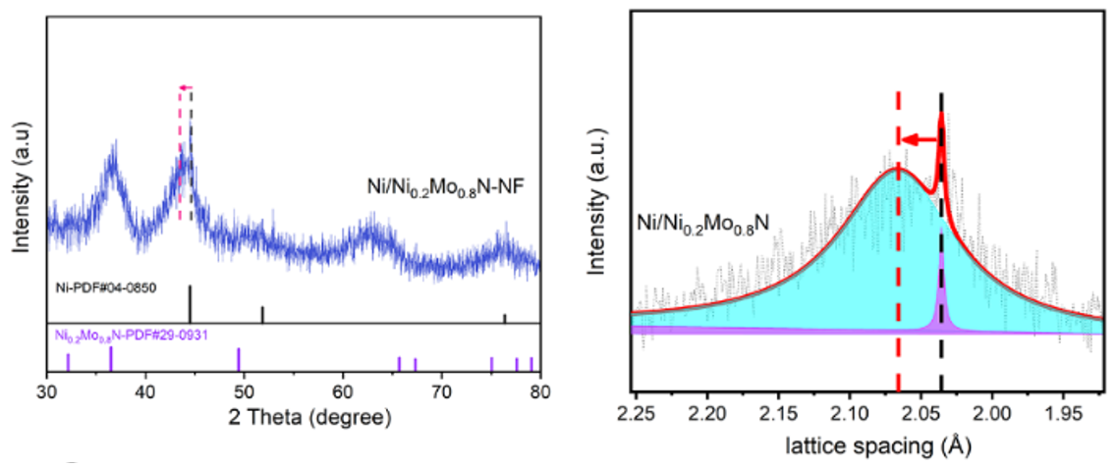
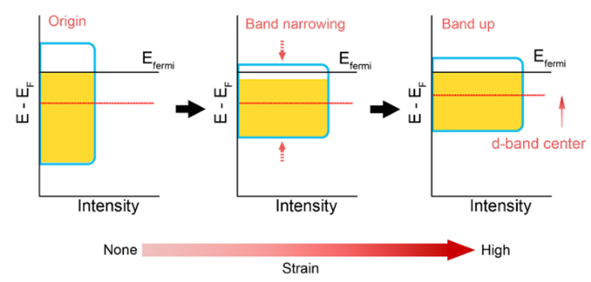
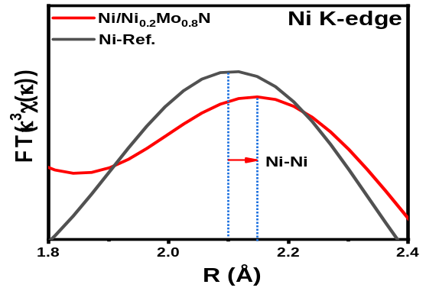
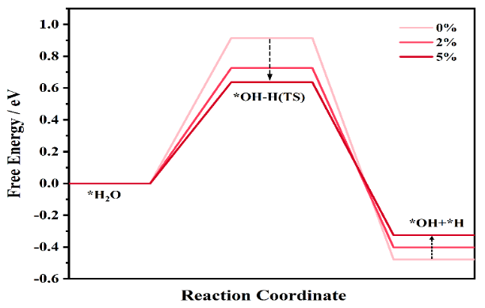
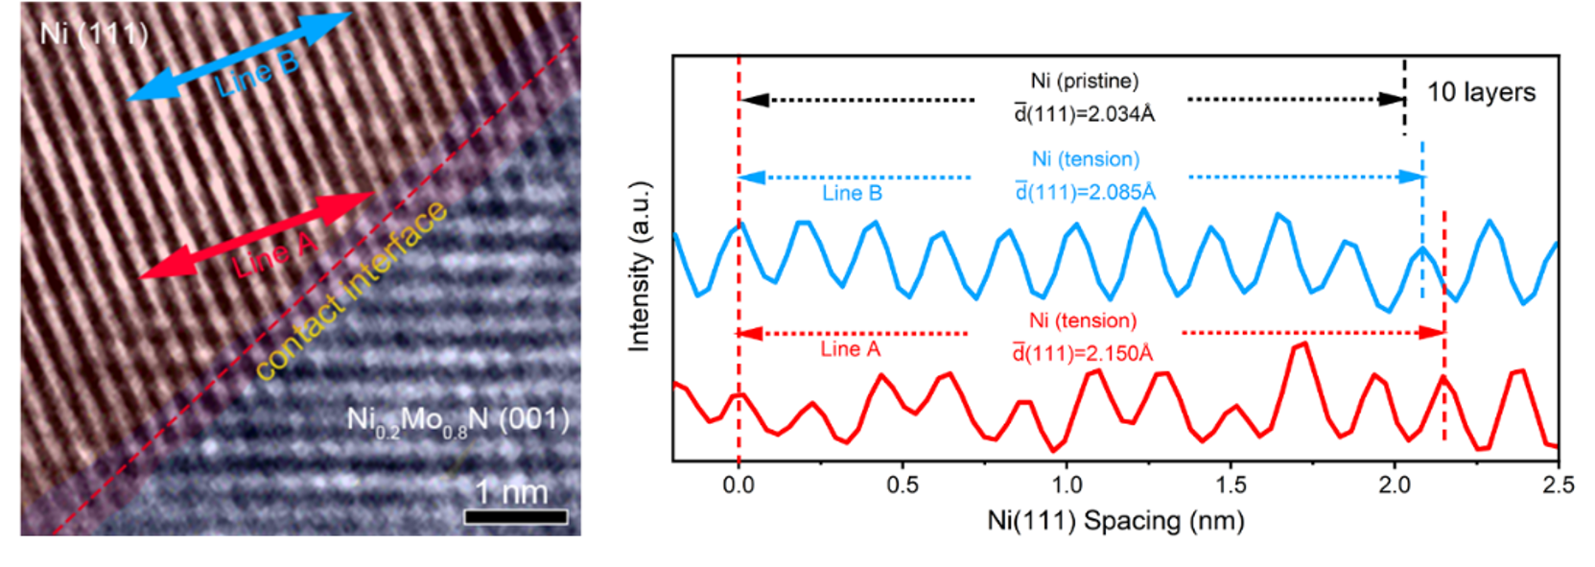
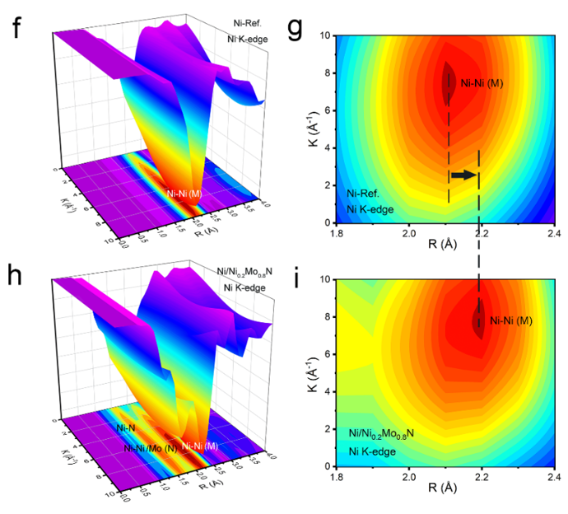
Tensile Strain Engineering of Ni
tensile stress causes an upward shift of the d-band center relative to the Fermi level in nickel
EXAFS
Upward of d band center
larger Ni-Ni bond length (2.16 Å)
compared to Ni-Ref (2.10 Å)
Ni-Ref R ≈ 2.1 Å
Ni/Ni_{0.2}Mo_{0.8}N R ≈ 2.18 Å
increase the free energy of *OH + *H
decrease transition state free energy
Guoju Huang, Yanshuo Jin,* Shuhui Sun*, Hui Meng*, in preparation

Slide 28
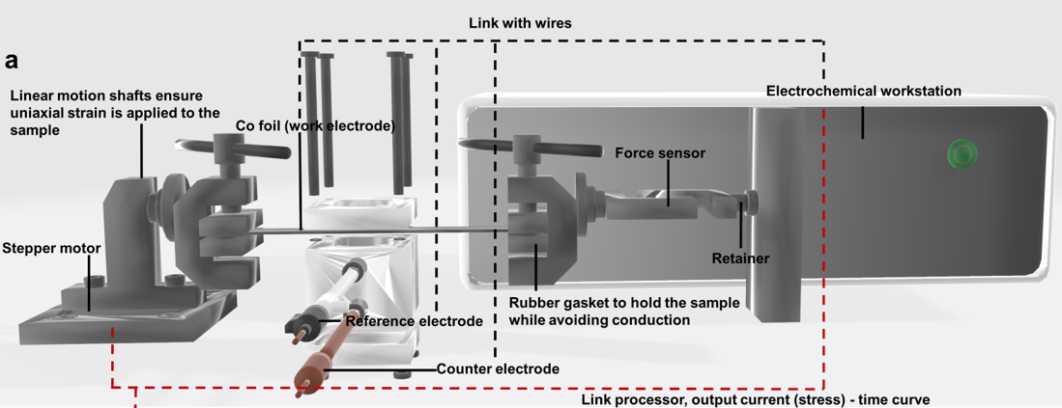
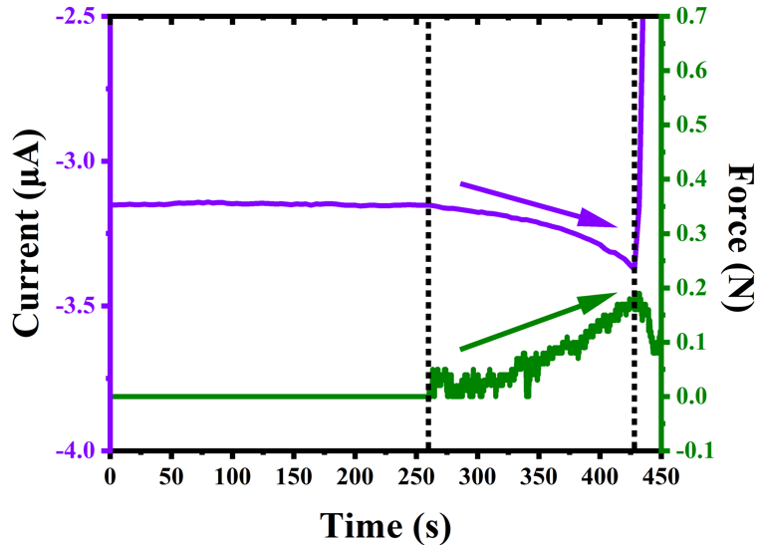
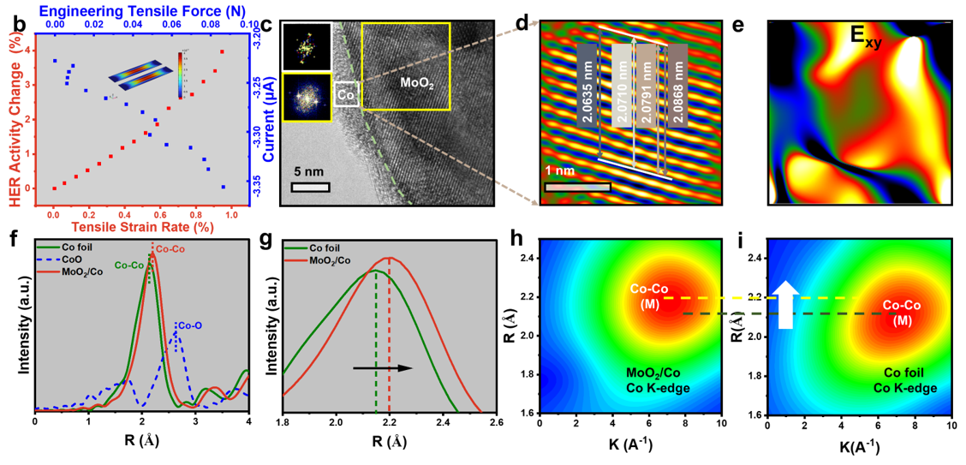
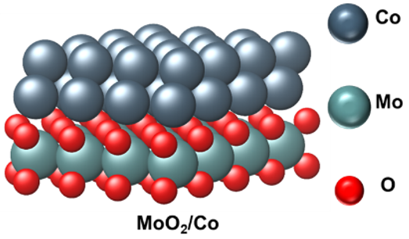
Tensile Strain Engineering and electron deficiency of Co
the HER activity increased with increasing tensile strain, reaching a 6% enhancement at a stress of 0.175 N
Unpublished work

Slide 29
Elastic Modulus
The elastic modulus can be thought of as the stiffness of the material
  A material with a large elastic modulus is very stiff and difficult to deform
    Like the spring constant
  stress = Elastic modulus x strain

Slide 30
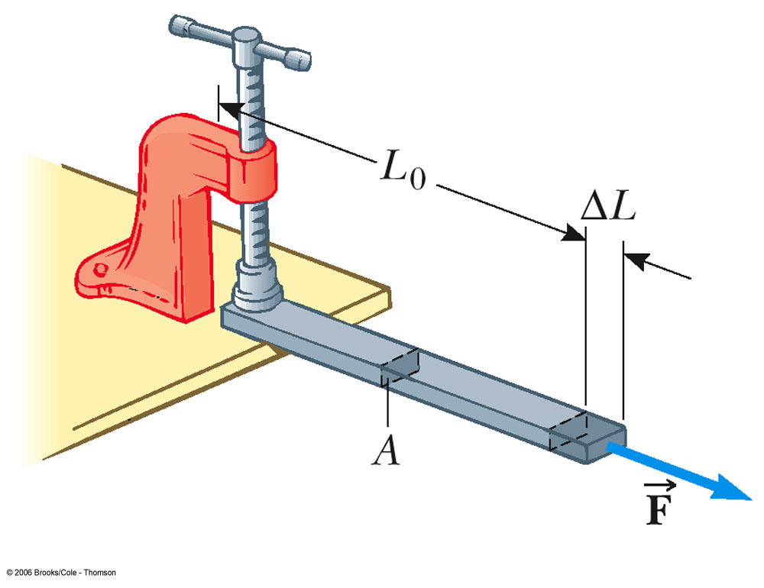
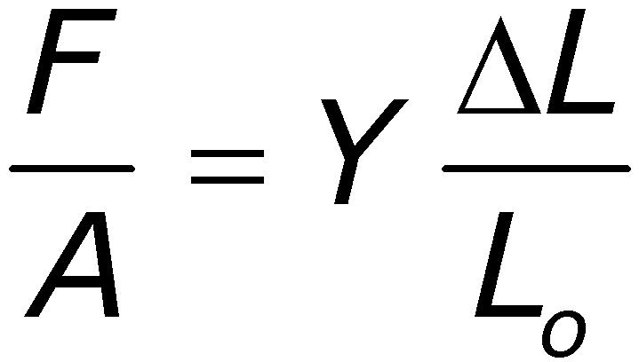
Young’s Modulus:
Elasticity in Length
Tensile stress is the ratio of the external force to the cross-sectional area
  Tensile is because the bar is under tension

Slide 31
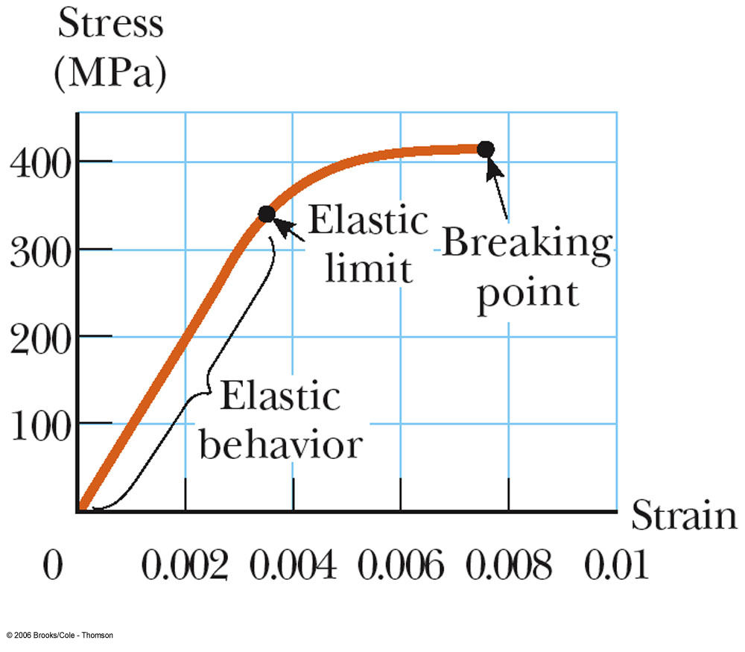
Elastic Limit
Young’s modulus applies to a stress of either tension or compression
It is possible to exceed the elastic limit of the material
  No longer directly proportional
  Ordinarily does not return to its original length

Slide 32
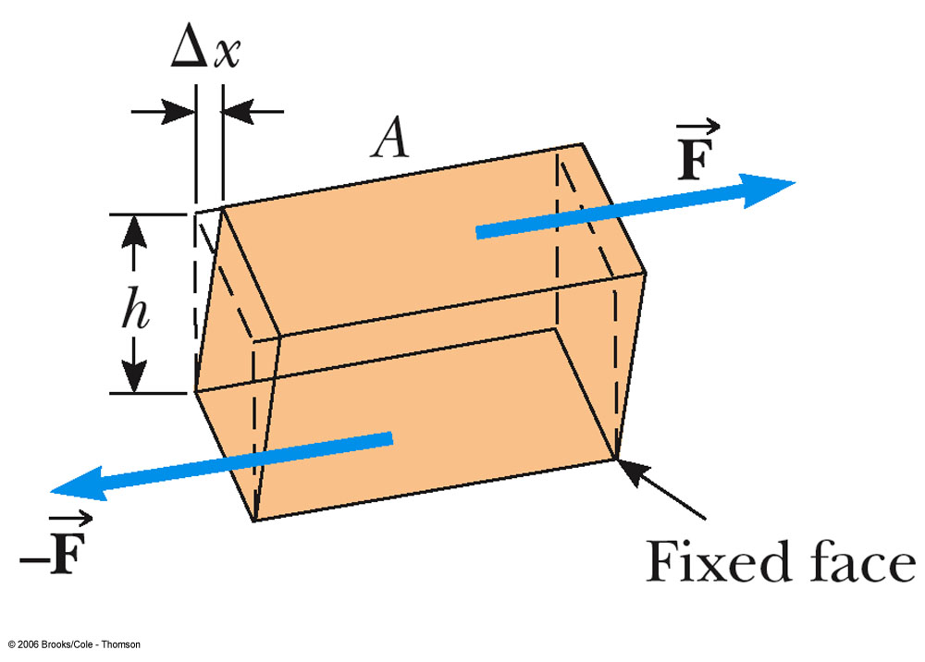
Shear Modulus:
Elasticity of Shape
Forces may be parallel to one of the object’s faces
The stress is called a shear stress
The shear strain is the ratio of the horizontal displacement and the height of the object

Slide 33
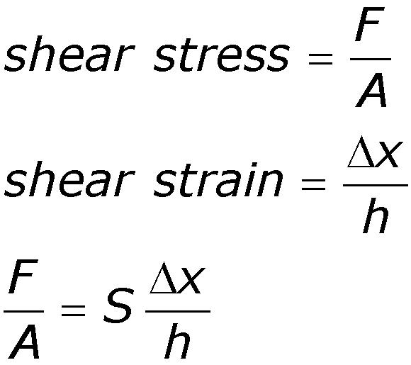
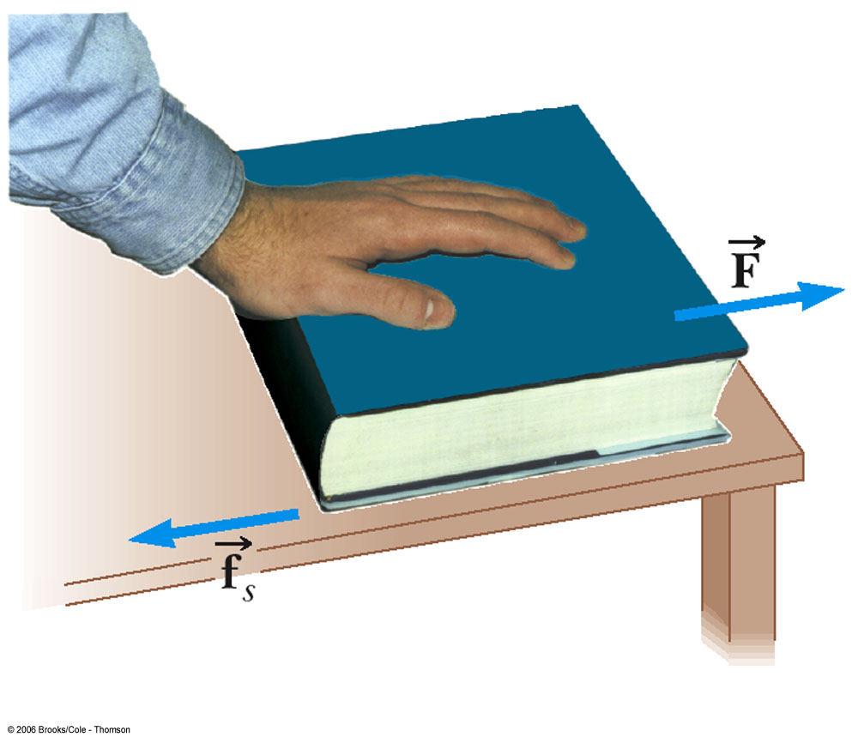
Shear Modulus Equation
S is the shear modulus
A material having a large shear modulus is difficult to bend

Slide 34
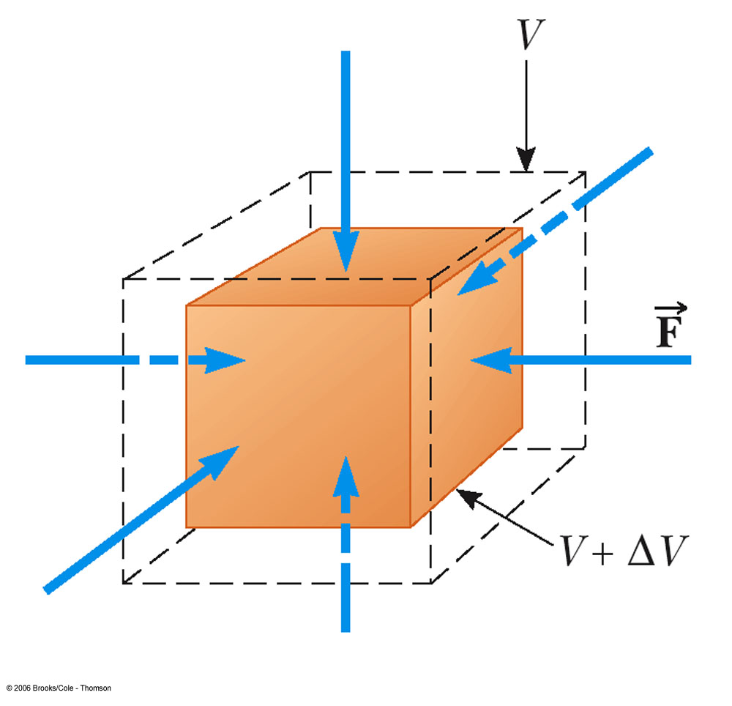
Bulk Modulus
Bulk modulus characterizes the response of an object to uniform squeezing
Volume stress, ∆P, is the ratio of the force to the surface area
  This is also the Pressure
The volume strain is equal to the ratio of the change in volume to the original volume

Slide 35
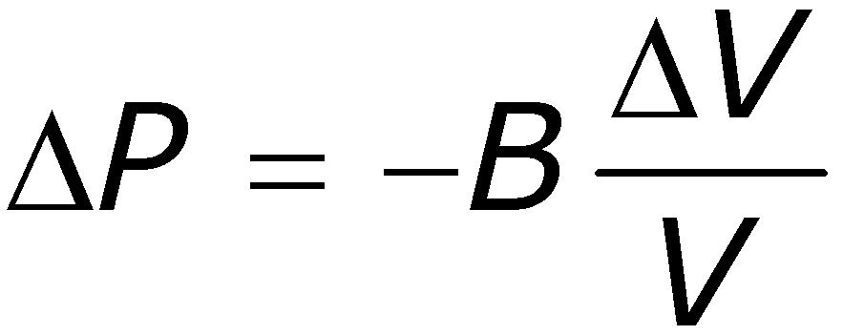
Bulk Modulus Equation
A material with a large bulk modulus is difficult to compress
The negative sign is included since an increase in pressure will produce a decrease in volume
  B is always positive
The compressibility is the reciprocal of the bulk modulus

Slide 36
Notes on Moduli
Solids have Young’s, Bulk, and Shear moduli
Liquids have only bulk moduli, they will not undergo a shearing or tensile stress
  The liquid would flow instead

Slide 37
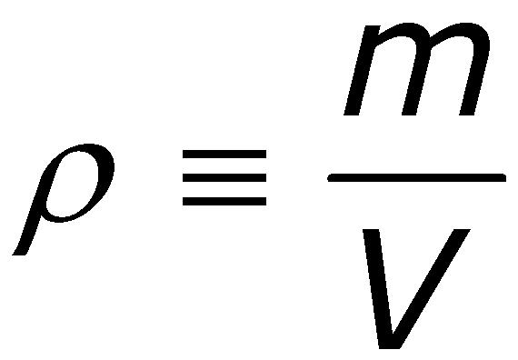
Density
The density of a substance of uniform composition is defined as its mass per unit volume:
Units are kg/m³ (SI) or g/cm³ (cgs)
1 g/cm³ = 1000 kg/m³
The densities of most liquids and solids vary slightly with temperature and pressure
Densities of gases vary greatly with changes in temperature and pressure

Slide 38
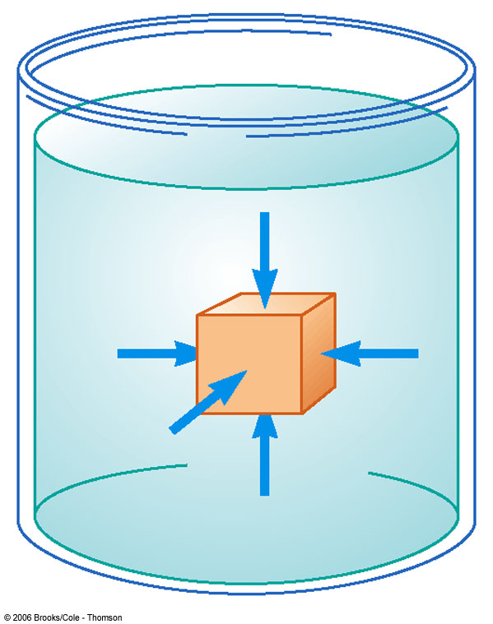
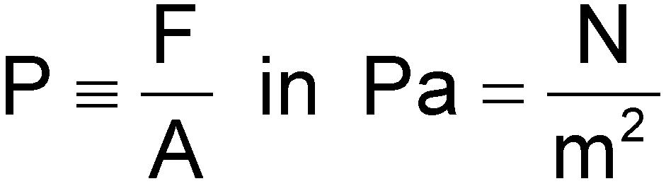
Pressure
The force exerted by a fluid on a submerged object at any point if perpendicular to the surface of the object

Slide 39
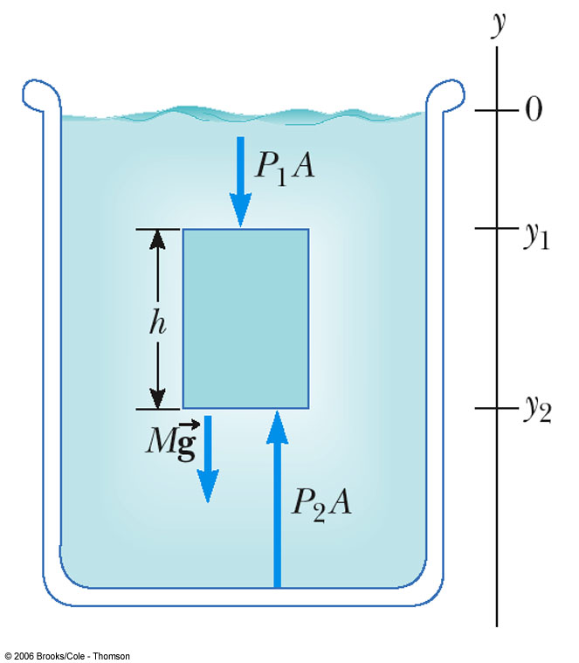
Pressure and Depth
If a fluid is at rest in a container, all portions of it must be in static equilibrium
All points at the same depth must be at the same pressure
  Otherwise, the fluid would not be in equilibrium
Consider darker region: Three external forces act on the region

Slide 40
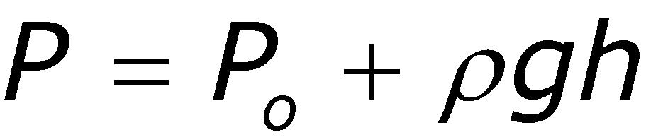
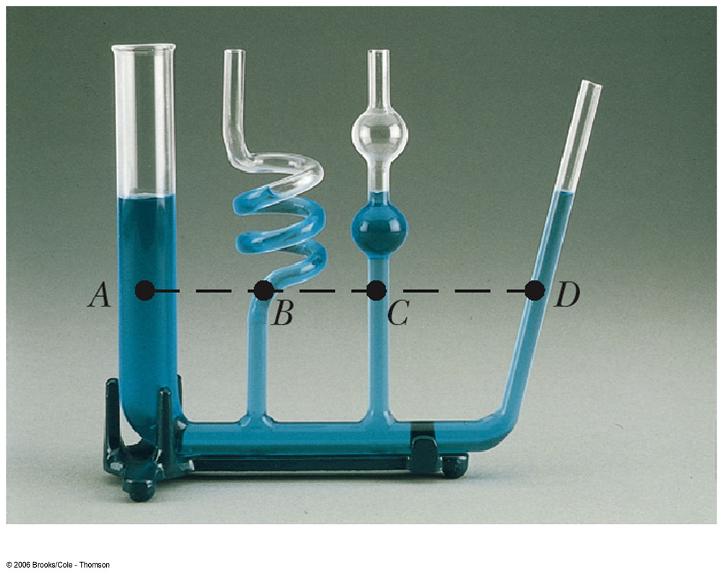
Pressure and Depth equation
P_{o} is normal atmospheric pressure
  1.013 x 10⁵ Pa = 14.7 lb/in²
The pressure does not depend upon the shape of the container

Slide 41
Quick Quiz
The pressure at the bottom of a glass filled with water (ρ=1000 kg/m³) is P. The water is poured out, and the glass filled with ethyl alcohol (ρ=806 kg/m³). Now the pressure at the bottom of the glass is
  Smaller than P
  Larger than P
  Equal to P
  Indeterminate

Slide 42
Pascal’s Principle
A change in pressure applied to an enclosed fluid is transmitted undiminished to every point of the fluid and to the walls of the container.
  First recognized by Blaise Pascal, a French scientist (1623 – 1662)

Slide 43
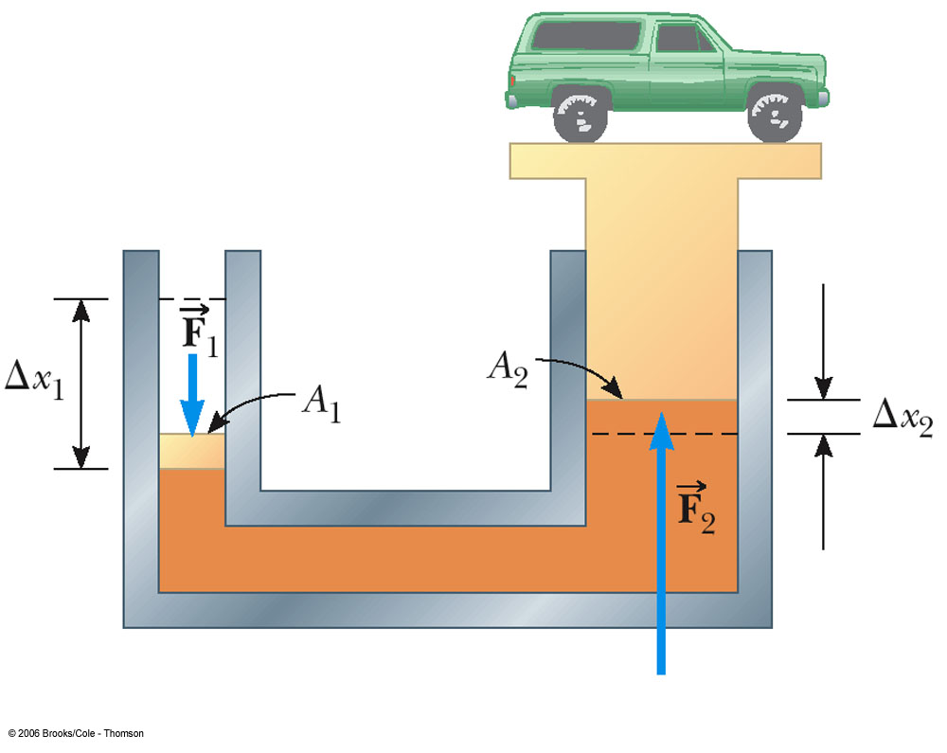
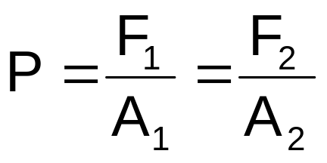
Pascal’s Principle, cont
The hydraulic press is an important application of Pascal’s Principle
Also used in hydraulic brakes, forklifts, car lifts, etc.

Slide 44
Car Lift
At a service station, compressed air exerts a force F₁ on a piston of circular cross-section r₁. The pressure is transmitted through an incompressible fluid to a second piston of r₂.
Show that the work done by the input and output pistons is the same.

Slide 45
Absolute vs. Gauge Pressure
The pressure P is called the absolute pressure
  Remember, P = P_{o} + ρgh
P – P_{o} = ρgh is the gauge pressure

Slide 46
Pressure Values in Various Units
One atmosphere of pressure is defined as the pressure equivalent to a column of mercury exactly 0.76 m tall at 0º C where g = 9.806 65 m/s²
One atmosphere (1 atm) =
  76.0 cm of mercury
  1.013 x 10⁵ Pa
  14.7 lb/in²

Slide 47
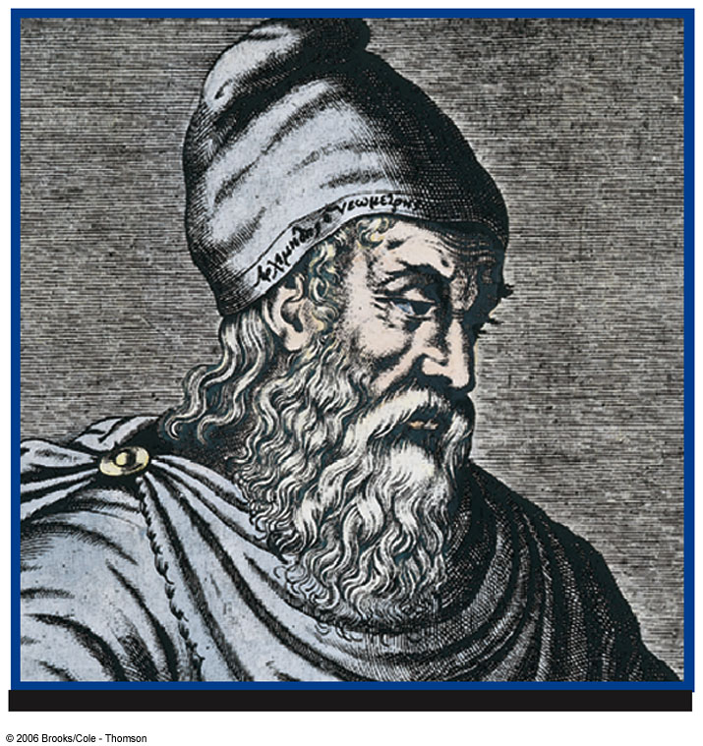
Archimedes' Principle
Any object completely or partially submerged in a fluid is buoyed up by a force whose magnitude is equal to the weight of the fluid displaced by the object.

Slide 48
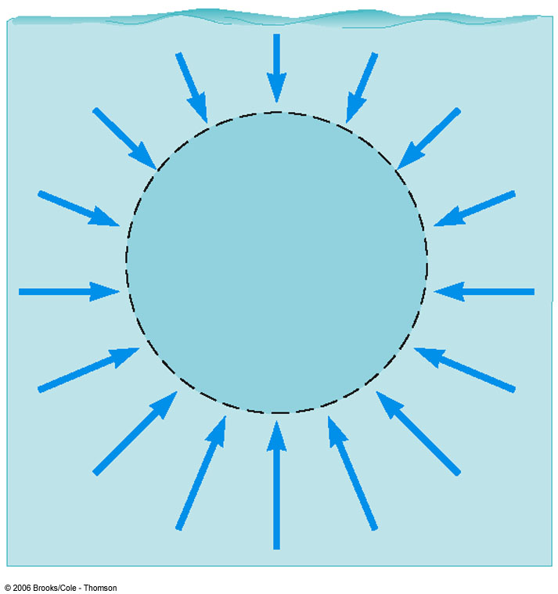
Buoyant Force
The upward force is called the buoyant force
The physical cause of the buoyant force is the pressure difference between the top and the bottom of the object

Slide 49
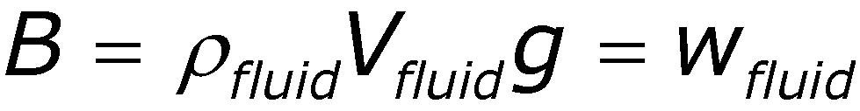
More Buoyant Force
The magnitude of the buoyant force always equals the weight of the displaced fluid
The buoyant force is the same for a totally submerged object of any size, shape, or density

Slide 50
Archimedes’ Principle:
Totally Submerged Object
The upward buoyant force is B=ρ_{fluid}gV_{obj}
The downward gravitational force is
w=mg= ρ_{obj}gV_{obj}
The net force is
B-w=(ρ_{fluid}- ρ_{obj})gV_{obj}

Slide 51
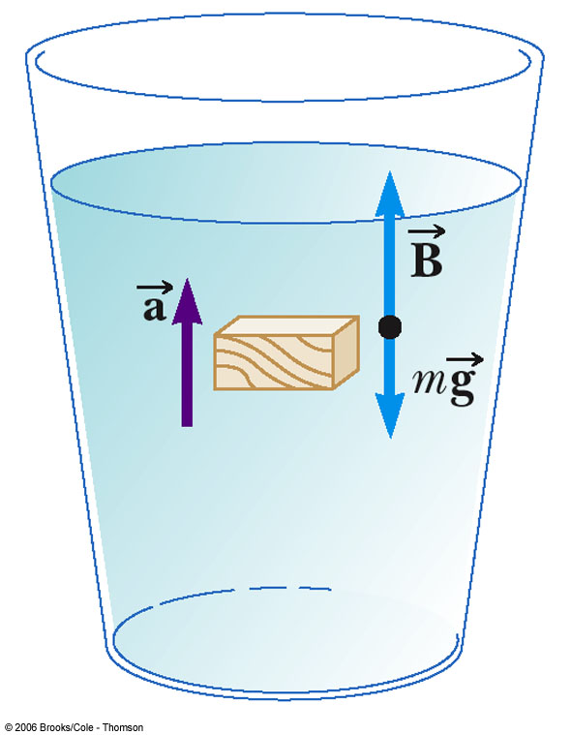
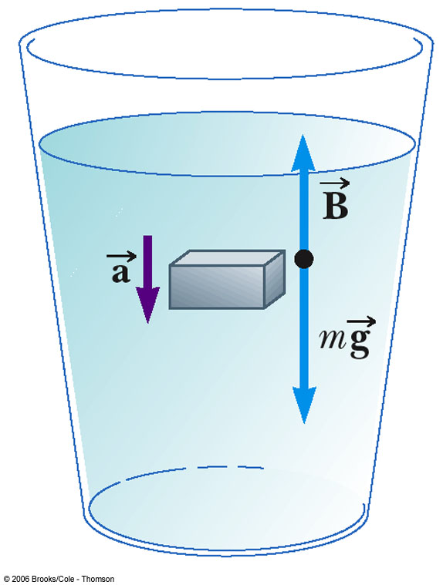
Rising and Sinking

Slide 52
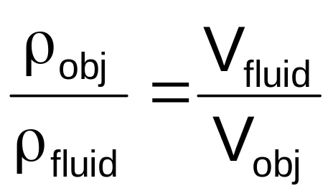

Archimedes’ Principle:
Floating Object
The forces balance

Slide 53

Example
You buy a gold crown and want to know if it is really gold.
It’s weight is 7.84 N.
In water, the weight is 6.86 N.
Is it gold?

Slide 54
Fluids in Motion:
Streamlines
Streamline flow
  Every particle that passes a particular point moves exactly along the smooth path followed by particles that passed the point earlier
  Also called laminar flow
Streamline is the path
  Different streamlines cannot cross each other
  The streamline at any point coincides with the direction of fluid velocity at that point

Slide 55

Streamline Flow
Streamline flow shown around an auto in a wind tunnel

Slide 56
Fluids in Motion:
Turbulent Flow
The flow becomes irregular
  exceeds a certain velocity
  any condition that causes abrupt changes in velocity
Eddy currents are a characteristic of turbulent flow

Slide 57

Turbulent Flow
The rotating blade (dark area) forms a vortex in heated air
  The wick of the burner is at the bottom
Turbulent air flow occurs on both sides of the blade

Slide 58
Characteristics of an Ideal Fluid
The fluid is nonviscous
  There is no internal friction between adjacent layers
The fluid is incompressible
  Its density is constant
The fluid motion is steady
  Its velocity, density, and pressure do not change in time
The fluid moves without turbulence
  No eddy currents are present
  The elements have zero angular velocity about its center

Slide 59

Equation of Continuity
A₁v₁ = A₂v₂
The product of the cross-sectional area of a pipe and the fluid speed is a constant
  Speed is high where the pipe is narrow and speed is low where the pipe has a large diameter
Av is called the flow rate

Slide 60

Bernoulli’s Equation
States that the sum of the pressure, kinetic energy per unit volume, and the potential energy per unit volume has the same value at all points along a streamline

Slide 62

Application – Golf Ball
The dimples in the golf ball help move air along its surface
The ball pushes the air down
Newton’s Third Law tells us the air must push up on the ball
The spinning ball travels farther than if it were not spinning

Slide 63

Application – Airplane Wing
The air speed above the wing is greater than the speed below
The air pressure above the wing is less than the air pressure below
There is a net upward force
  Called lift
Other factors are also involved

Slide 64

Hole in a Tank
Consider a tank with a hole. The top is open to the atmosphere.
  Determine the speed at which water leaves the hole if it is 0.500 m below the water level.
  Where does the stream hit the ground if the hole is 3.00 m above the ground?

Slide 65
Chapter 13
Vibrations
and
Waves

Slide 66
Hooke’s Law
F_{s} = - k x
  F_{s} is the spring force
  k is the spring constant
    It is a measure of the stiffness of the spring
      A large k indicates a stiff spring and a small k indicates a soft spring
  x is the displacement of the object from its equilibrium position
    x = 0 at the equilibrium position
  The negative sign indicates that the force is always directed opposite to the displacement

Slide 67
Hooke’s Law Force
The force always acts toward the equilibrium position
  It is called the restoring force
The direction of the restoring force is such that the object is being either pushed or pulled toward the equilibrium position

Slide 68

Hooke’s Law Applied to a Spring – Mass System
When x is positive (to the right), F is negative (to the left)
When x = 0 (at equilibrium), F is 0
When x is negative (to the left), F is positive (to the right)

Slide 69
Motion of the Spring-Mass System
Assume the object is initially pulled to a distance A and released from rest
As the object moves toward the equilibrium position, F and a decrease, but v increases
At x = 0, F and a are zero, but v is a maximum
The object’s momentum causes it to overshoot the equilibrium position

Slide 70
Motion of the Spring-Mass System, cont
The force and acceleration start to increase in the opposite direction and velocity decreases
The motion momentarily comes to a stop at x = - A
It then accelerates back toward the equilibrium position
The motion continues indefinitely

Slide 71
Simple Harmonic Motion
Motion that occurs when the net force along the direction of motion obeys Hooke’s Law
  The force is proportional to the displacement and always directed toward the equilibrium position
The motion of a spring mass system is an example of Simple Harmonic Motion

Slide 72
Simple Harmonic Motion, cont.
Not all periodic motion over the same path can be considered Simple Harmonic motion
To be Simple Harmonic motion, the force needs to obey Hooke’s Law

Slide 73
Amplitude
Amplitude, A
  The amplitude is the maximum position of the object relative to the equilibrium position
  In the absence of friction, an object in simple harmonic motion will oscillate between the positions x = ±A

Slide 74
Period and Frequency
The period, T, is the time that it takes for the object to complete one complete cycle of motion
  From x = A to x = - A and back to x = A
The frequency, ƒ, is the number of complete cycles or vibrations per unit time
  ƒ = 1 / T
  Frequency is the reciprocal of the period

Slide 75
Acceleration of an Object in Simple Harmonic Motion
Newton’s second law will relate force and acceleration
The force is given by Hooke’s Law
F = - k x = m a
  a = -kx / m
The acceleration is a function of position
  Acceleration is not constant and therefore the uniformly accelerated motion equation cannot be applied

Slide 76
Elastic Potential Energy
A compressed spring has potential energy
  The compressed spring, when allowed to expand, can apply a force to an object
  The potential energy of the spring can be transformed into kinetic energy of the object

Slide 77
Elastic Potential Energy, cont
The energy stored in a stretched or compressed spring or other elastic material is called elastic potential energy
  PE_{s} = 1/2kx²
The energy is stored only when the spring is stretched or compressed
Elastic potential energy can be added to the statements of Conservation of Energy and Work-Energy

Slide 78

Energy in a Spring Mass System
A block sliding on a frictionless system collides with a light spring
The block attaches to the spring
The system oscillates in Simple Harmonic Motion

Slide 79

Energy Transformations
The block is moving on a frictionless surface
The total mechanical energy of the system is the kinetic energy of the block

Slide 80

Energy Transformations, 2
The spring is partially compressed
The energy is shared between kinetic energy and elastic potential energy
The total mechanical energy is the sum of the kinetic energy and the elastic potential energy

Slide 81

Energy Transformations, 3
The spring is now fully compressed
The block momentarily stops
The total mechanical energy is stored as elastic potential energy of the spring

Slide 82

Energy Transformations, 4
When the block leaves the spring, the total mechanical energy is in the kinetic energy of the block
The spring force is conservative and the total energy of the system remains constant

Slide 83

Velocity as a Function of Position
Conservation of Energy allows a calculation of the velocity of the object at any position in its motion
  Speed is a maximum at x = 0
  Speed is zero at x = ±A
  The ± indicates the object can be traveling in either direction

Slide 84

Simple Harmonic Motion and Uniform Circular Motion
A ball is attached to the rim of a turntable of radius A
The focus is on the shadow that the ball casts on the screen
When the turntable rotates with a constant angular speed, the shadow moves in simple harmonic motion

Slide 85


Period and Frequency from Circular Motion
Period
  This gives the time required for an object of mass m attached to a spring of constant k to complete one cycle of its motion
Frequency
  Units are cycles/second or Hertz, Hz

Slide 86

Angular Frequency
The angular frequency is related to the frequency
The frequency gives the number of cycles per second
The angular frequency gives the number of radians per second

Slide 87
Effective Spring Mass
A graph of T² versus m does not pass through the origin
The spring has mass and oscillates
For a cylindrical spring, the effective additional mass of a light spring is 1/3 the mass of the spring

Slide 88

Motion as a Function of Time
Use of a reference circle allows a description of the motion
x = A cos (2πƒt)
  x is the position at time t
  x varies between +A and -A

Slide 89

Graphical Representation of Motion
When x is a maximum or minimum, velocity is zero
When x is zero, the velocity is a maximum
When x is a maximum in the positive direction, a is a maximum in the negative direction

Slide 90
Motion Equations
Remember, the uniformly accelerated motion equations cannot be used
x = A cos (2πƒt) = A cos ωt
v = -2πƒA sin (2πƒt) = -A ω sin ωt
a = -4π²ƒ²A cos (2πƒt) =
-Aω² cos ωt

Slide 91

Verification of Sinusoidal Nature
This experiment shows the sinusoidal nature of simple harmonic motion
The spring mass system oscillates in simple harmonic motion
The attached pen traces out the sinusoidal motion

Slide 92

Simple Pendulum
The simple pendulum is another example of simple harmonic motion
The force is the component of the weight tangent to the path of motion
  F_{t} = - m g sin θ

Slide 93
Simple Pendulum, cont
In general, the motion of a pendulum is not simple harmonic
However, for small angles, it becomes simple harmonic
  In general, angles < 15° are small enough
  sin θ = θ
  F_{t} = - m g θ
    This force obeys Hooke’s Law

Slide 94

Period of Simple Pendulum
This shows that the period is independent of the amplitude
The period depends on the length of the pendulum and the acceleration of gravity at the location of the pendulum

Slide 95

Simple Pendulum Compared to a Spring-Mass System

Slide 96

Physical Pendulum
A physical pendulum can be made from an object of any shape
The center of mass oscillates along a circular arc

Slide 97

Period of a Physical Pendulum
The period of a physical pendulum is given by
  I is the object’s moment of inertia
  m is the object’s mass
For a simple pendulum, I = mL² and the equation becomes that of the simple pendulum as seen before

Slide 98
Wave Motion
A wave is the motion of a disturbance
Mechanical waves require
  Some source of disturbance
  A medium that can be disturbed
  Some physical connection between or mechanism though which adjacent portions of the medium influence each other
All waves carry energy and momentum

Slide 99

Types of Waves – Traveling Waves
Flip one end of a long rope that is under tension and fixed at one end
The pulse travels to the right with a definite speed
A disturbance of this type is called a traveling wave

Slide 100

Types of Waves – Transverse
In a transverse wave, each element that is disturbed moves in a direction perpendicular to the wave motion

Slide 101

Types of Waves – Longitudinal
In a longitudinal wave, the elements of the medium undergo displacements parallel to the motion of the wave
A longitudinal wave is also called a compression wave

Slide 102
Other Types of Waves
Waves may be a combination of transverse and longitudinal
A soliton consists of a solitary wave front that propagates in isolation
  First studied by John Scott Russell in 1849
  Now used widely to model physical phenomena

Slide 103

Waveform – A Picture of a Wave
The brown curve is a “snapshot” of the wave at some instant in time
The blue curve is later in time
The high points are crests of the wave
The low points are troughs of the wave

Slide 104

Longitudinal Wave Represented as a Sine Curve
A longitudinal wave can also be represented as a sine curve
Compressions correspond to crests and stretches correspond to troughs
Also called density waves or pressure waves

Slide 105

Description of a Wave
A steady stream of pulses on a very long string produces a continuous wave
The blade oscillates in simple harmonic motion
Each small segment of the string, such as P, oscillates with simple harmonic motion

Slide 106

Amplitude and Wavelength
Amplitude is the maximum displacement of string above the equilibrium position
Wavelength, λ, is the distance between two successive points that behave identically

Slide 107
Speed of a Wave
v = ƒ λ
  Is derived from the basic speed equation of distance/time
This is a general equation that can be applied to many types of waves

Slide 108

Speed of a Wave on a String
The speed on a wave stretched under some tension, F
  μ is called the linear density
The speed depends only upon the properties of the medium through which the disturbance travels

Slide 109
Interference of Waves
Two traveling waves can meet and pass through each other without being destroyed or even altered
Waves obey the Superposition Principle
  If two or more traveling waves are moving through a medium, the resulting wave is found by adding together the displacements of the individual waves point by point
  Actually only true for waves with small amplitudes

Slide 110

Constructive Interference
Two waves, a and b, have the same frequency and amplitude
  Are in phase
The combined wave, c, has the same frequency and a greater amplitude

Slide 111

Constructive Interference in a String
Two pulses are traveling in opposite directions
The net displacement when they overlap is the sum of the displacements of the pulses
Note that the pulses are unchanged after the interference

Slide 112

Destructive Interference
Two waves, a and b, have the same amplitude and frequency
They are 180° out of phase
When they combine, the waveforms cancel

Slide 113

Destructive Interference in a String
Two pulses are traveling in opposite directions
The net displacement when they overlap is decreased since the displacements of the pulses subtract
Note that the pulses are unchanged after the interference

Slide 114

Reflection of Waves –
Fixed End
Whenever a traveling wave reaches a boundary, some or all of the wave is reflected
When it is reflected from a fixed end, the wave is inverted
The shape remains the same

Slide 115

Reflected Wave – Free End
When a traveling wave reaches a boundary, all or part of it is reflected
When reflected from a free end, the pulse is not inverted

Slide 116


